Slide 1



Multilevel Models of NBA Salaries
Gavin Martinez and Sahib Dhaliwal

Slide 2
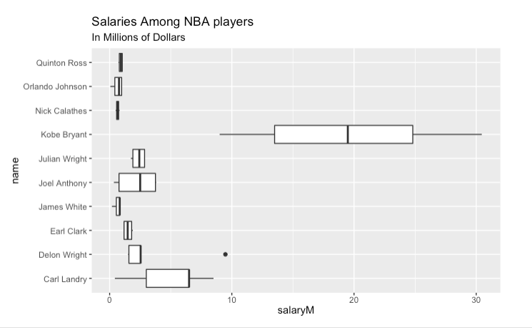
Introduction
NBA data set has around 8,000 observations on player salaries, including variables like team, position, and year.
Took a sample of the NBA data set, “samp”, and ran our models using the smaller dataset
Variables:
Position: effect coded variable (F = forward, G = guard, C = center)(Level 2)
Season.c: grand mean centered season variable (2000-2020)(Level 1)
Research Question:
Does the relationship between season and salary vary by player?
Are there differences in NBA player salaries in general?

Slide 3
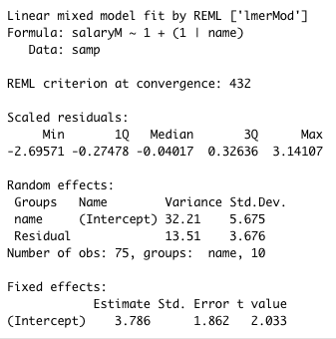
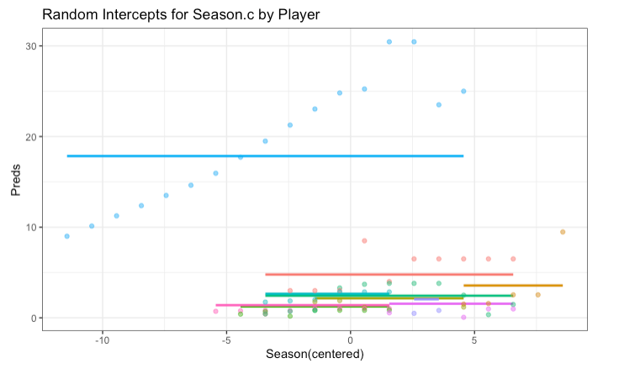
Null model
Level 1: salaryM_{ij}= β_{0j}+ ε_{ij}
Level 2: β_{0j} = β₀₀+u_{0j}
u_{0j}∼N(0,𝛕²)
e_{ij} ~ N(0,𝝈²)
Seems to be significant player to player variation in salaries
Much more variation in salaries between players than between timepoints for a given player
Predicted salary for an average player is about $3.786 million
Allows average salaries to vary from player to player, but doesn’t seem to fit the points very well.

Slide 4
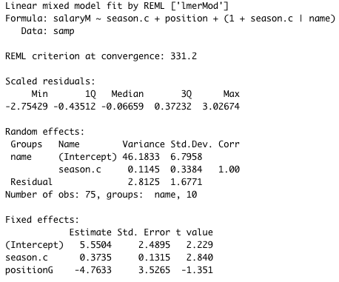
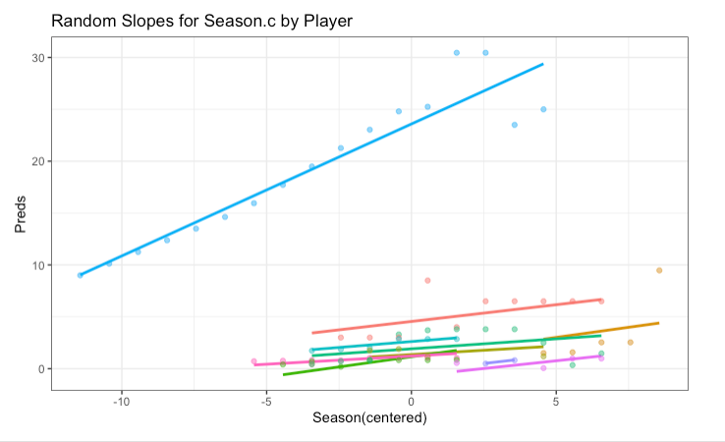
Updated Model
Adding season.c and position explain nearly 80% of the variability in salaries for a given player, however increases player to player variation (𝝉²)
Level 1: salaryM_{ij}= β_{0j}+ β_{1j}(season.c)_{ij} + ε_{ij}
Level 2: β_{0j} = β₀₀ + β₀₁(position)_{j} + u_{0j}
β_{1j} = β₁₀ + β₁₁(position)_{j} + u_{1j}
u_{0j}∼N(0,𝛕²)
u_{1j}∼N(0,𝛕²)
e_{ij} ~ N(0,𝝈²)
Allows for the effect of season.c to change from player to player

Slide 5
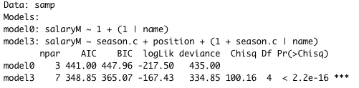
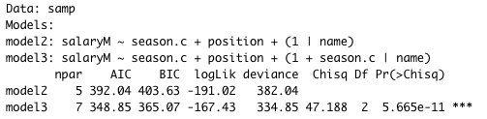
Model Comparisons
Model including random slopes is significantly better fitting than model without using random slopes (Chi-squared value = 47.1888, DF = 2, p-value = 5.66e-11)
As expected, the final model is a significantly better fit than the initial model (Chi-squared value = 100.16, DF = 4, p-value < 2.2e-16)

Slide 6
Possible Limitations/Changes
Randomly sampled data set, “samp” does not have any players that play center, so we cannot apply any generalizations to them based on our analysis.
Adding players like Kobe inflates player to player variability
Must consider whether to keep him or not
Also might consider taking a larger sample.
Notice that adding season.c and position actually increased the player to player (Level 2) variability in salaries
This could mean that the effect of season.c from player to player is of opposite sign than the effect of season.c for a given player.
Does not mean model is wrong, but could be something to look out for and acknowledge

Slide 7
Interpretations of Final Model
Predicted salary for an average forward in 2011 is about $5.5504 million (average year in data set)
Predicted increase in salary for an average forward every year after 2011 is about $373,500.
Predicted decrease in salary for an average guard in 2011 is about $4.7633 million.

